Slide 1
Creating an efficient compression based DNA sequence clustering algorithm for the analysis and comparison of metagenomes
Ashwin Sekar¹
Huzefa Rangwala²
¹Poolesville High School, Poolesville, MD
²George Mason University, Vienna, VA

Slide 2
Metagenomics
Environmental Genomics
Seeks to find diversity, richness, functionality, relationships, etc.
Understanding microorganisms
Possibly contains uncultured or uncultivated organisms
Very slow and inaccurate

Slide 3
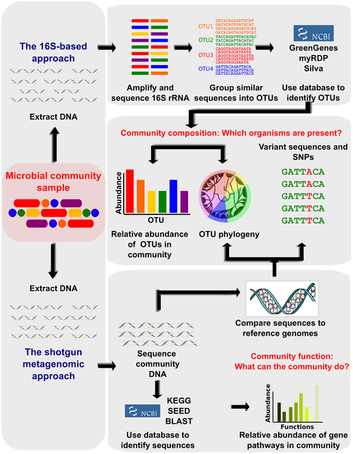
16S Approach

Slide 4
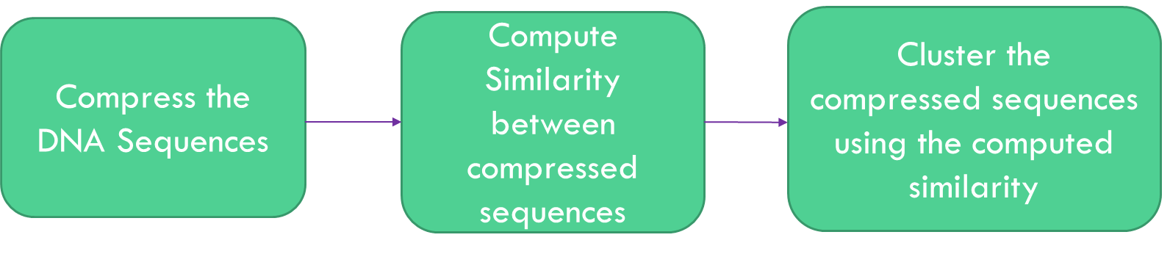
Creating a better clustering algorithm
Clustering algorithms use similarity to cluster
Similarity method is unique to clustering algorithm
Introduce compression with relevant similarity measure

Slide 5
Experiment
Test 3 compression methods with 2 similarity measures for a total of 6 algorithms
3 stage testing
Compare to 7 currently used clustering algorithms

Slide 6
Compression method: Sequitur
to
t
he
d
her
from
her
pus
he
e
e
her
Rule 1 ->
Rule 2 ->
1 r
1
1
2
2
2

Slide 7
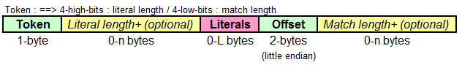
Compression Method: LZ4
CAGACTTGACATTGAAGGAACCTGCTAGAAATAGCGGGGTGCTCTTCGGAGCCCATGAAA
-80 67 65 71 65 67 84 84 71 65 67 65 6 0 -16 9 65 71

Slide 8
Compression Method: RLE
Run length encoding
aaaaabbccbbbcbb
a5b2c2b3cb2

Slide 9
Similarity Measure: CDM
Compression based Dissimilarity Measures
$$CDM=\frac{\left.size of M(a+b\right)}{size of M(a)+size of M(b)}$$

Slide 10

Similarity Measure: CD
Compression distance
Sequitur $= \frac{size of A∪B }{size of A+size of B}$A and B are the set of rules used in a and b
RLE and LZ4 – edit distance
Insert, add, delete

Slide 11
Clustering
Most basic clustering algorithm
Random representative for each cluster
If similarity is greater than threshold, put the sequence in the cluster

Slide 12
The Algorithms
MC-Lz4DM (Metagenome Clustering using Lz4 based Dissimilarity Measurements)
MC-SeqDM (Metagenome Clustering using Sequitur based Dissimilarity Measurements)
MC-Lz4CD (Metagenome Clustering using Lz4 based Compression Distances)
MC-RLEDM (Metagenome Clustering using RLE based Dissimilarity Measurements)
MC-SeqCD (Metagenome Clustering using Sequitur based Compression Distances)
MC-RLECD (Metagenome Clustering using RLE based Compression Distances)

Slide 13
Evaluation
Stage 1 – Test each similarity measure with compression for relevancy
Compare against raw similarity (Ground truth)
Stage 2 – Test against human generated sample
Test the similarity measure for clustering relevancy
Stage 3 – Test remaining algorithms with actual field sample
Standard metrics – Time, # of clusters, Weighted Similarity
Diversity metrics – Shannon index, Chao1 index, ACE index

Slide 14
Stage 1 results
Stage 1 Evaluation using 112R data set from 16S environmental set of samples
Algorithm | MC-SeqCD | MC-Lz4CD | MC-RLECD | MC-SeqDM | MC-Lz4DM | MC-RLEDM
Percent match with Ground Truth | 2.06 | 91.2 | 84.9 | 86.3 | 86.2 | .011
MC-SeqCD and MC-RLEDM scored very low, eliminated for Stage 2
The similarity measure was not compatible with compression method

Slide 15
Stage 2 Results
Stage 2 Results using 16S Simulated Data Set
Algorithm | 3% error | 5% error
MC-Lz4DM | 49 | 62
MC-Lz4CD | 63 | 65
MC-SeqDM | 220 | 212
MC-RLECD | 240 | 232
MC-MinH | 39 | 37
MC-LSH | 47 | 41
UCLUST | 91 | 53
CD-HIT | 108 | 47
ESPRIT | 180 | 86
DOTUR | 210 | 135
Mothur | 214 | 138
Manmade data set with 43 clusters
Split into 2 sets with introduced error to mimic real data
MC-SeqDM and MC-RLECD eliminated
Similarity measure did not mesh with clustering method

Slide 16
Stage 3 Results
Average metrics for the 6 samples of the 16S Environmental Data set
Algorithm | MC-Lz4DM | MC-Lz4CD | MC-MinH | MC-LSH | UCLUST | CD-HIT | ESPRIT | DOTUR | Mothur
# of Clusters | 1419 | 1302 | 1634 | 1795 | 1561 | 1196 | 1361 | 1854 | 1853
Weighted Similarity | 98.72% | 98.50% | 91.18 | 91.33 | 91.02 | 90.61 | 90.88 | 91.33 | 91.33
Time (s) | 23.9 | 43.6 | 3.3 | 317.0 | 2.0 | 3.9 | 537.0 | 5567.0 | 12303.0
Average diversity metrics for the 6 samples of the 16S Environmental Data set
Algorithm | MC-Lz4DM | MC-Lz4CD | MC-MinH
Chao1 Index | 3304.4 | 3060.4 | 3931.3
Shannon Index | 5.1 | 5.1 | 5.3
ACE Index | 4479.5 | 4296.9 | 4202.7

Slide 17
Conclusion
Algorithms that follow criteria of compression approach show increased accuracy and comparable speed
Diversity is maintained
Compression based approach is validated

Slide 18
What’s next?
Use better compression algorithms
Combine with high performing clustering algorithms
Repeat with more data sets
Why?
Next step for making Metagenomics an accessible laboratory procedure
Open doors in biological research

Slide 19
Acknowledgements
Professor Huzefa Rangwala, George Mason University
Mr. Curran
Dr. Stone
Mr. Estep and Mr. Stansbury
Friends and Family
Annie Chu

